Slide 1
Mark 6 : 30-56

Slide 2
³⁰ The apostles returned to Jesus and told him all that they had done and taught. ³¹ And he said to them, “Come away by yourselves to a desolate place and rest a while.” For many were coming and going, and they had no leisure even to eat. ³² And they went away in the boat to a desolate place by themselves. ³³ Now many saw them going and recognised them, and they ran there on foot from all the towns and got there ahead of them. ³⁴ When he went ashore he saw a great crowd, and he had compassion on them, because they were like sheep without a shepherd. And he began to teach them many things. ³⁵ And when it grew late, his disciples came to him and said, “This is a desolate place, and the hour is now late.

Slide 3
³⁶ Send them away to go into the surrounding countryside and villages and buy themselves something to eat.” ³⁷ But he answered them, “You give them something to eat.” And they said to him, “Shall we go and buy two hundred denarii worth of bread and give it to them to eat?” ³⁸ And he said to them, “How many loaves do you have? Go and see.” And when they had found out, they said, “Five, and two fish.” ³⁹ Then he commanded them all to sit down in groups on the green grass. ⁴⁰ So they sat down in groups, by hundreds and by fifties. ⁴¹ And taking the five loaves and the two fish, he looked up to heaven and said a blessing and broke the loaves and gave them to the disciples to set before the people. And he divided the two fish among them all.

Slide 4
⁴² And they all ate and were satisfied. ⁴³ And they took up twelve baskets full of broken pieces and of the fish. ⁴⁴ And those who ate the loaves were five thousand men.
⁴⁵ Immediately he made his disciples get into the boat and go before him to the other side, to Bethsaida, while he dismissed the crowd. ⁴⁶ And after he had taken leave of them, he went up on the mountain to pray. ⁴⁷ And when evening came, the boat was out on the sea, and he was alone on the land. ⁴⁸ And he saw that they were making headway painfully, for the wind was against them.

Slide 5
And about the fourth watch of the night he came to them, walking on the sea. He meant to pass by them, ⁴⁹ but when they saw him walking on the sea they thought it was a ghost, and cried out, ⁵⁰ for they all saw him and were terrified. But immediately he spoke to them and said, “Take heart; it is I. Do not be afraid.” ⁵¹ And he got into the boat with them, and the wind ceased. And they were utterly astounded, ⁵² for they did not understand about the loaves, but their hearts were hardened.

Slide 6
⁵³ When they had crossed over, they came to land at Gennesaret and moored to the shore. ⁵⁴ And when they got out of the boat, the people immediately recognised him ⁵⁵ and ran about the whole region and began to bring the sick people on their beds to wherever they heard he was. ⁵⁶ And wherever he came, in villages, cities, or countryside, they laid the sick in the marketplaces and implored him that they might touch even the fringe of his garment. And as many as touched it were made well.

Slide 7
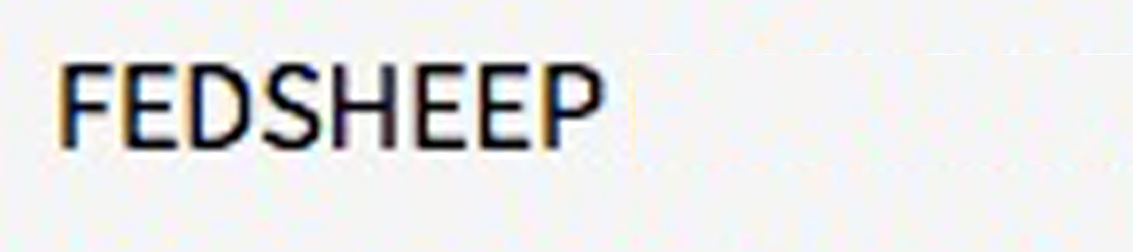
The Feeding of the 5000 Reveals the Identity of Jesus – The Christ, The Son of God
The Value of Christian Retreat / Rest / Recreation
Time out from our regular Christian service, to rest; be alone with God; be alone with other Christians
Some never have R&R&R – burn out
Some want too much R&R&R – never engage with mission
Don’t be selfish (all too ‘precious’) about guarding our R&R&R
Sometimes God interrupts our R&R&R.
(A God-ordained opportunity to impact a person’s life for Him)
The Value of Good Biblical Teaching
God’s sheep need to be shepherded
A sheep without a shepherd is someone who is genuinely seeking God. Need Teaching.
All disciples of Jesus need regular, good, solid Bible teaching

Slide 8
Ephesians 4:11–14 (NIV84)
¹¹ It was he who gave some to be apostles, some to be prophets, some to be evangelists, and some to be pastors and teachers, ¹² to prepare God’s people for works of service, so that the body of Christ may be built up ¹³ until we all reach unity in the faith and in the knowledge of the Son of God and become mature, attaining to the whole measure of the fullness of Christ.
¹⁴ Then we will no longer be infants, tossed back and forth by the waves, and blown here and there by every wind of teaching and by the cunning and craftiness of men in their deceitful scheming.

Slide 9
The Feeding of the 5000 Reveals the Identity of Jesus – The Christ, The Son of God
The Value of Christian Retreat / Rest / Recreation
Time out from our regular Christian service, to rest; be alone with God; be alone with other Christians
Some never have R&R&R – burn out
Some want too much R&R&R – never engage with mission
Don’t be selfish (all too ‘precious’) about guarding our R&R&R
Sometimes God interrupts our R&R&R.
(A God-ordained opportunity to impact a person’s life for Him)
The Value of Good Biblical Teaching
God’s sheep need to be shepherded
A sheep without a shepherd is someone who is genuinely seeking God. Need Teaching.
All disciples of Jesus need regular, good, solid Bible teaching
Sheep without a shepherd:
Follow the wind of teaching
that isn’t the Gospel
Stay easily / wander off
Wander off after ‘Green pick’
what itching ears want to hear
Often fixate on themselves
Good, Regular teaching:
Keeps our faith strong
Urges us into mission
Guards against false teaching and heresy
Always keeps Christ at the centre
Holds the flock together

